Slide 1
Week3 Discussion Slides 1C
Akshay Shetty
TA, CS33
akshashe@ucla.edu

Slide 2
Good afternoon guys !
This is the agenda of the discussion
Introduction to Bomb lab
Stack frame

Slide 3
Bomb lab
How many of you read the lab details ?
Okay, lets go through one by one.
Rules
You have to download the your bomb from this link
http://lnxsrv02.seas.ucla.edu:15213
You will receive the bomb.tar which contains
Bomb – This is the executable
Bomb.c – This c file will tell you how the bomb proceeds
README – Your ID and email address
You can view the scoreboard at from this link
http://lnxsrv02.seas.ucla.edu:15213/scoreboard

Slide 4
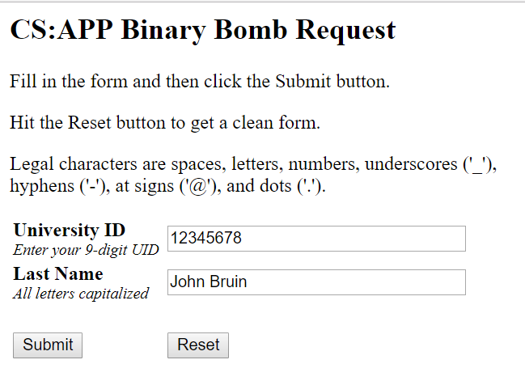
Requesting bomb tar from the website

Slide 5
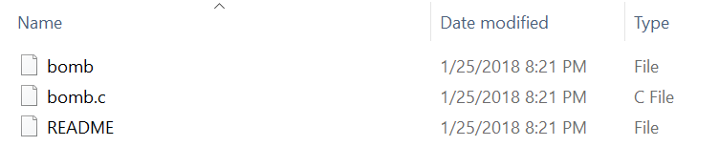
This is the executable that you need to
work on

Slide 6
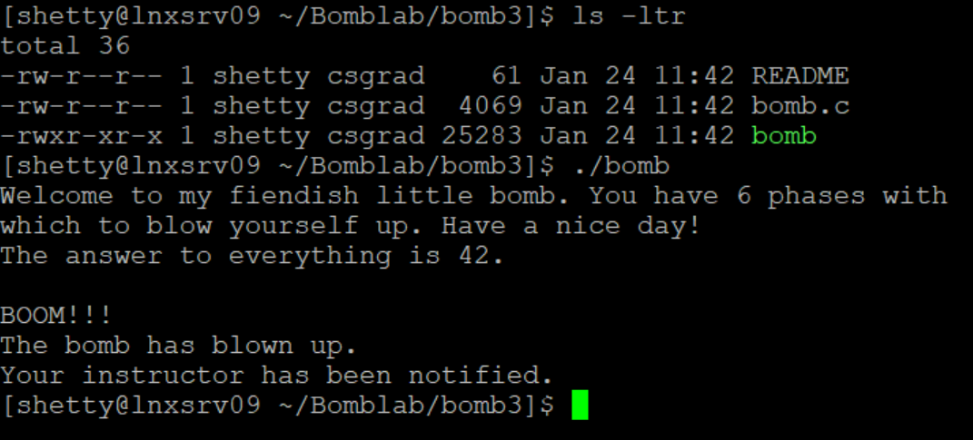
Lets try it out without any preparation

Slide 7
Scoreboard
Don’t worry. This is not a competition. The scoreboard will allow you to see your particular score at given moment
Scoring :
You have to find out 6 phrases .
Questions 1-4 have 10 points each
Question 5 and 6 have 15 points each .
Wrong answer , the bomb is triggered . ½ marks reduced for each bomb exploded. Max of 20 points

Slide 8
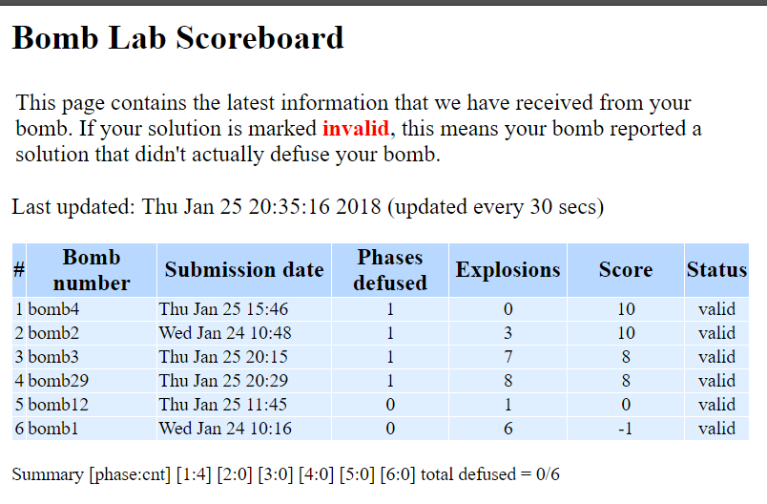
You can access the scoreboard at http://lnxsrv02.seas.ucla.edu:15213/scoreboard

Slide 9
Objdump and strings
objdump –d
Use this to disassemble all of the code in the bomb. You can also just look at individual functions.
Reading the assembler code can tell you how the bomb works.
objectdump –t
This will print out the bomb’s symbol table. The symbol table includes the names of all functions and
global variables in the bomb, the names of all the functions the bomb calls, and their addresses. You
may learn something by looking at the function names!
strings
Displays printable strings in your executable

Slide 10
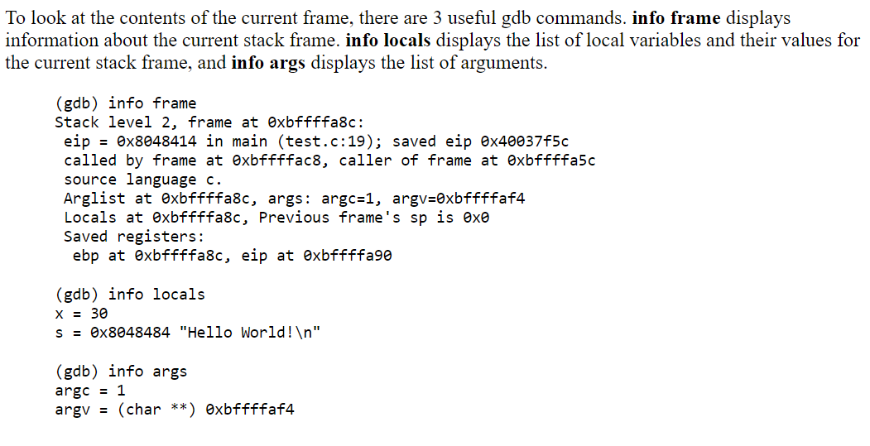
How do I examine the stack frame?

Slide 11
Thanks

